Slide 1

WELCOME TO BON VOYAGE RENTALS!
Project by:
Lakshmi Narayanan
Deepika Indran

Slide 2
INTRODUCTION
With youngsters increasingly viewing driving as a pleasure rather than a chore, car rentals have emerged as the perfect investment-free solution.
Bon Voyage Rentals is a hassle-free and user-friendly app which provides an effective system through which you can choose your desired car within minutes. It is extremely easy to pick the rental cars as there are multiple pickup points across the city and we make it possible for you to pick your car based on your travelling needs.

Slide 3

WHAT DO WE DO?
Bon Voyage Rentals is a car rental service app which helps ease the process of car rentals and returns, in Bengaluru
Through this app, one can easily view and select from a wide range of cars, according to their preferences. The app only handles the process of data storage and updation with respect to renting or returning cars. It does not provide facilities for payment transactions or real-time verifications of rents and returns.

Slide 4

MODULES AND SOFTWARES USED:
MySQL- A relational database management system
MySQL connector-To establish a connection between our database and python code
Python-Programming language used to make our app
Tkinter Module- To make the GUI elements to improve user experience

Slide 5
PROJECT OVERVIEW:
WELCOME PAGE
RENT WINDOW
RETURN WINDOW

Slide 6
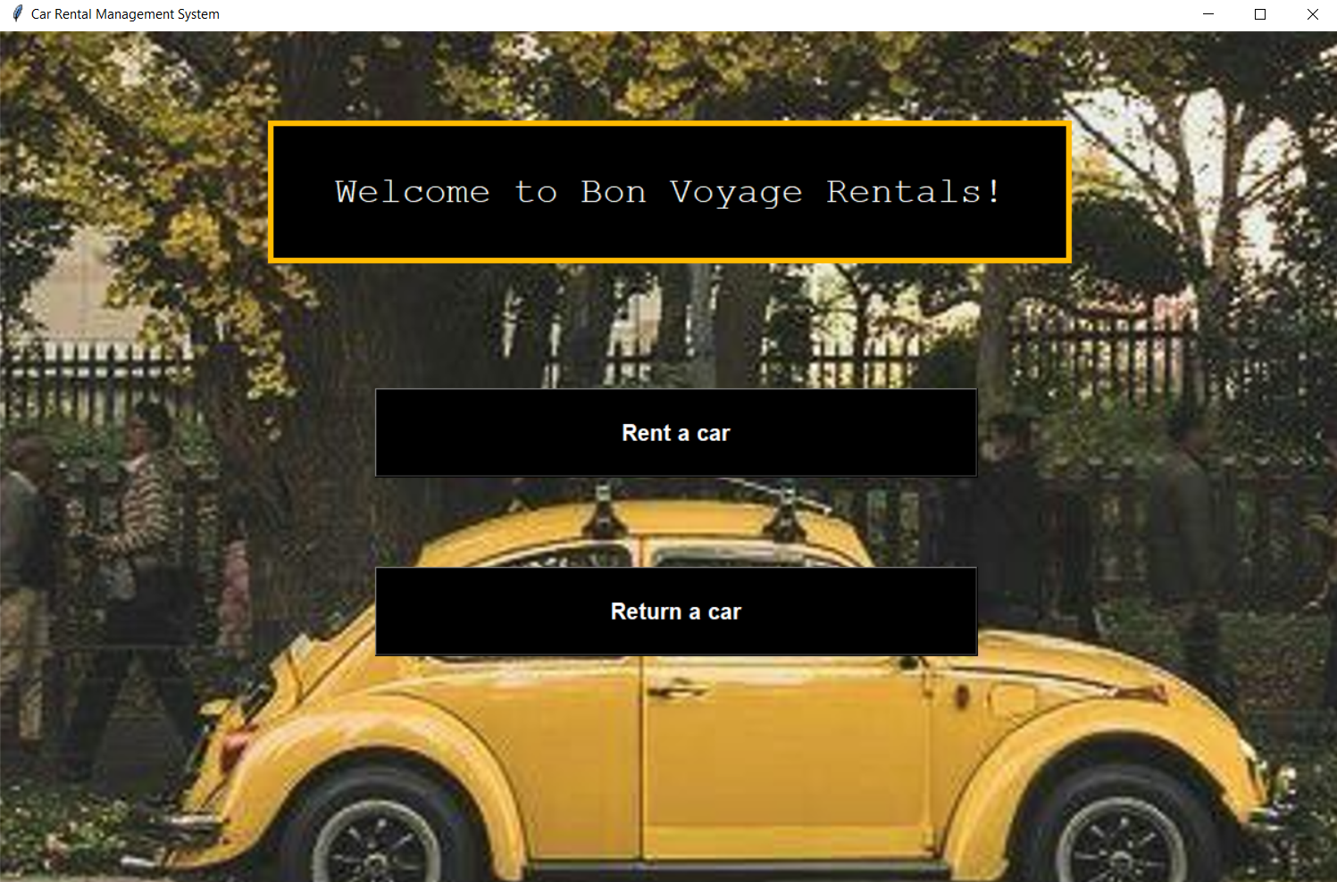
WELCOME PAGE:
The welcome page displays the name of the app and options to rent or return a car

Slide 7
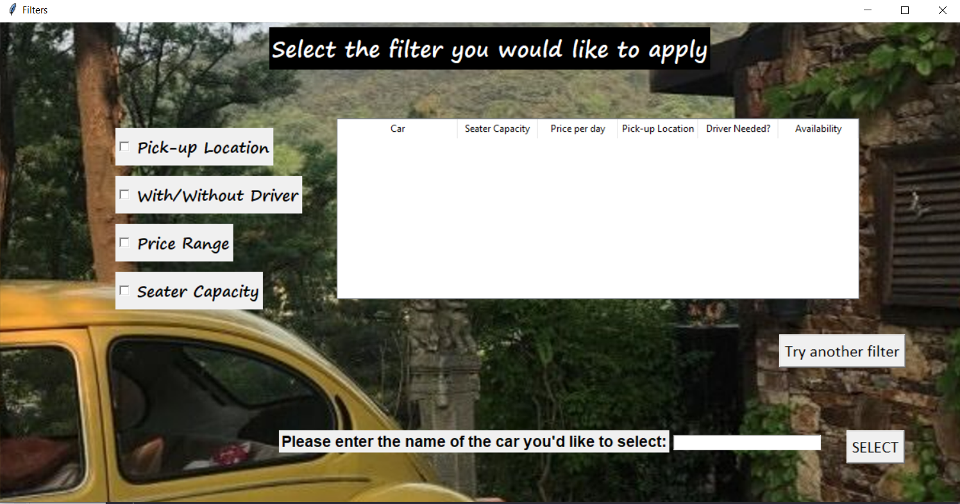
RENT WINDOW:
On clicking the ‘Rent’ button, a new window opens with a list of checkbuttons. This allows the user to select which filter they would like to apply:

Slide 8
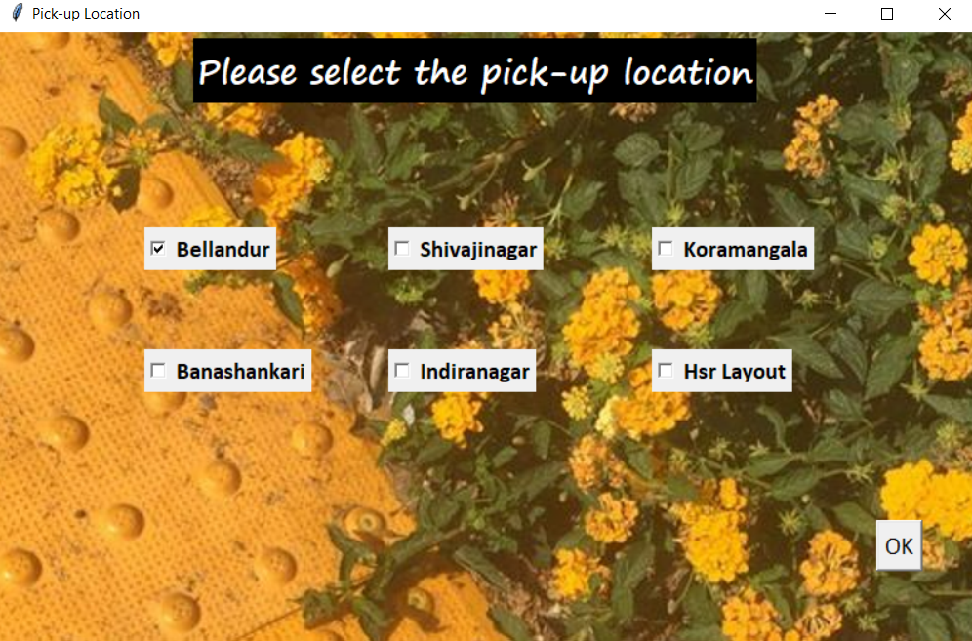
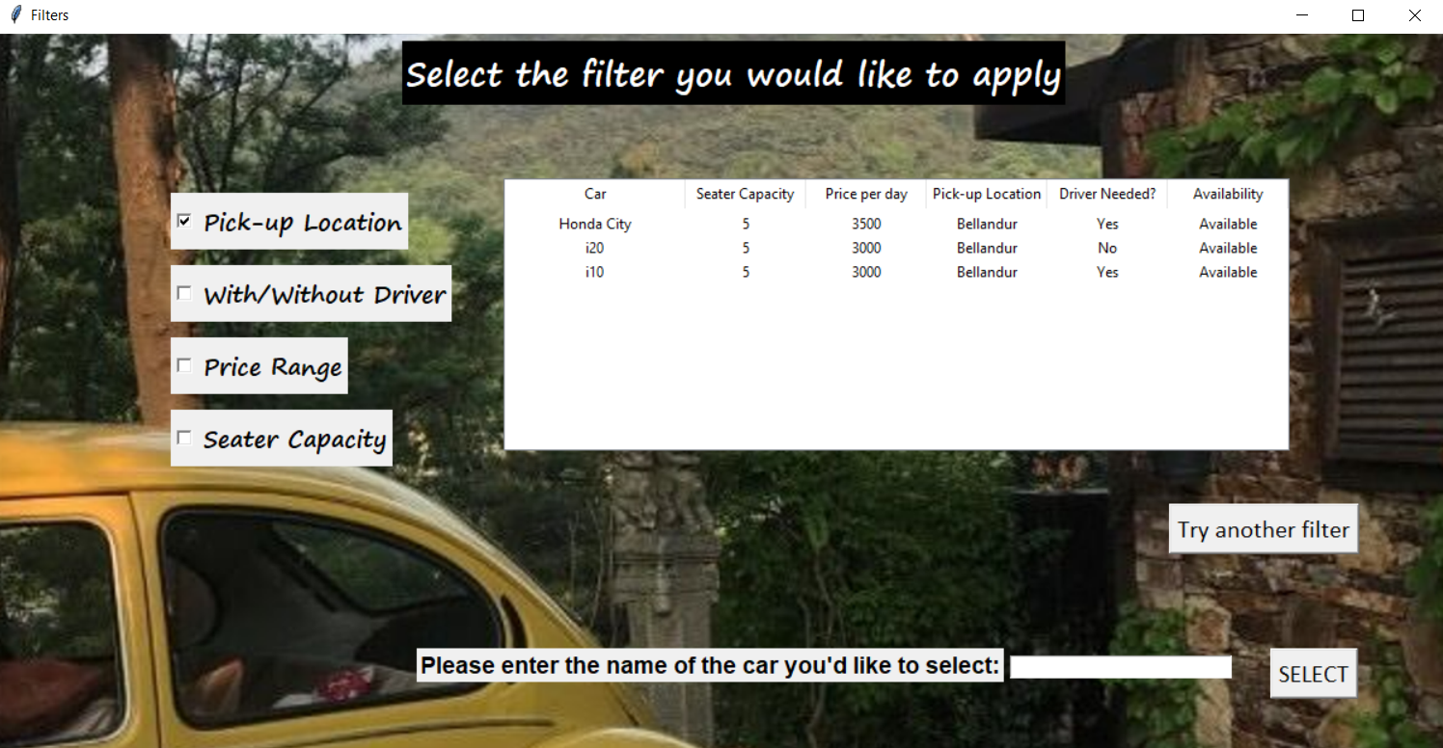
For example, if the ‘Pick-up Location’ filter is chosen, a list of available pick-up points is displayed as checkbuttons, for the user to choose from:
Once the user sets his preferences ,a list of available cars is displayed in the form of a table-

Slide 9
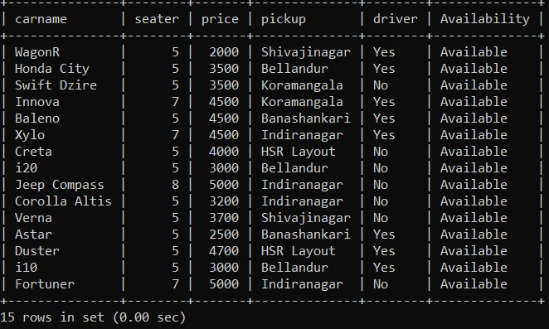
This list is selected and displayed from our database in MySQL. It can be seen that all the cars available at the pick-up location ‘Bellandur’, were displayed in the previous screenshot:

Slide 10
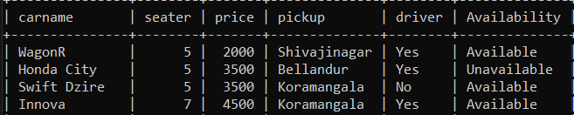
The user is then required to type the name of the car in the entry box provided:
This updates our database and changes the data in the ‘Availability’ column of the selected car, from ‘Available’ to ‘Unavailable’. It also displays a confirmation message on the window for the user:

Slide 11
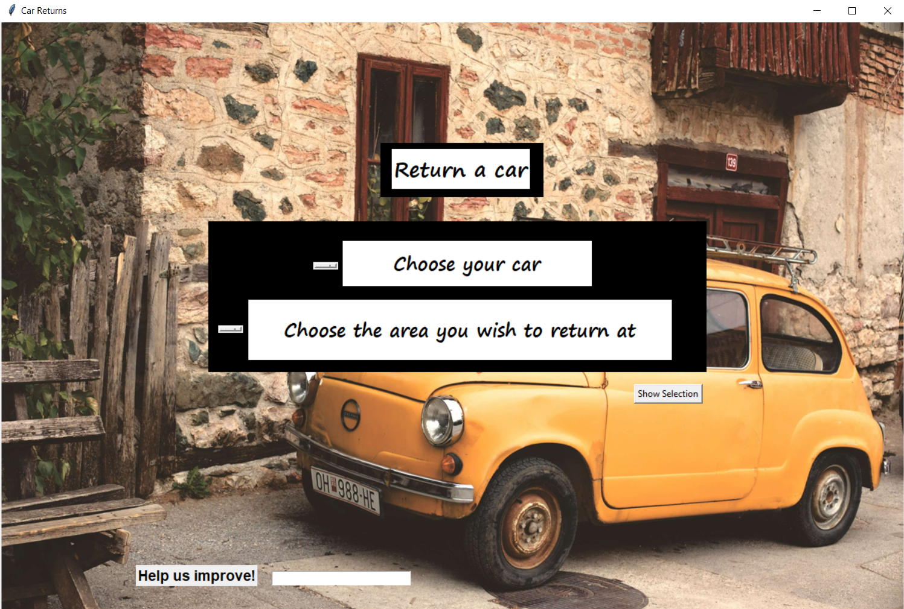
If the ‘Return’ button is clicked instead of the ‘Rent’ button, a new window opens displaying options to specify the name of the car and the location at which the user wishes to return the car:

Slide 12
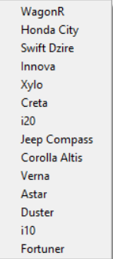
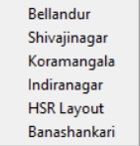
The return window has two drop-down menus-
To choose car to return
To choose area to return at
Displaying the following options-
The user is required to select the appropriate car and location to return the car at

Slide 13

The database is then updated with the newly returned car and a confirmation message is displayed on the screen:
An entry box is kept on the return window to fetch user feedback to improve services

Slide 14
THANK YOU!

